Slide 1

DAS INVADERS
ICS4U1 CPT
By: Christabelle Fu, Arjun Kalyan, Rhyle Majarais and Sandeep Saldanha

Slide 2
WHAT ARE WE DOING?
We are making a Das Invaders game which includes high performance shooting.
It is a Java based program which uses a GUI to run the program.
Some of the main components we used in our program are:
JFrames, JLabels, ArrayLists, threads, while loops, for statements, methods, a KeyListener, a MouseMotionListener, Math.random() methods, and ImageIcons

Slide 3
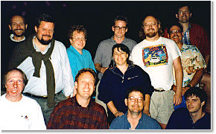
JAVA
Java technology was first created by Sun Microsystems in 1995
The entire Java team consisted of less than 30 people – they called themselves “the Green Team”
Patrick Naughton, Mike Sheridan, and James Gosling (workers of Sun Microsystems) had first come up with the idea in 1991

Slide 4
To keep Java a secret, the Green Team locked themselves away in an office and cut all communication with Sun Microsystems
For 18 months, they worked around the clock
They finally came up with a demo that worked properly in 1992
The language was first created by James Gosling in which he named “Oak”, after the tree in front of his window
After the project gained a bit of popularity, the team moved to a larger office and renamed themselves “the FirstPerson team”

Slide 5
In 1995, the language name was changed from “Oak” to “Java” before the launch of Java Technology was officially announced
GUI
Pronounced “gooey”, GUI stands for “graphical user interface
This interface allows a user to interact with a program easier
It uses components from the Swing package so that making buttons, labels, windows, etc. are easier
The 3 main components of a GUI are:
Graphical components
Listener methods
Application methods

Slide 6
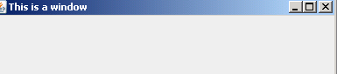
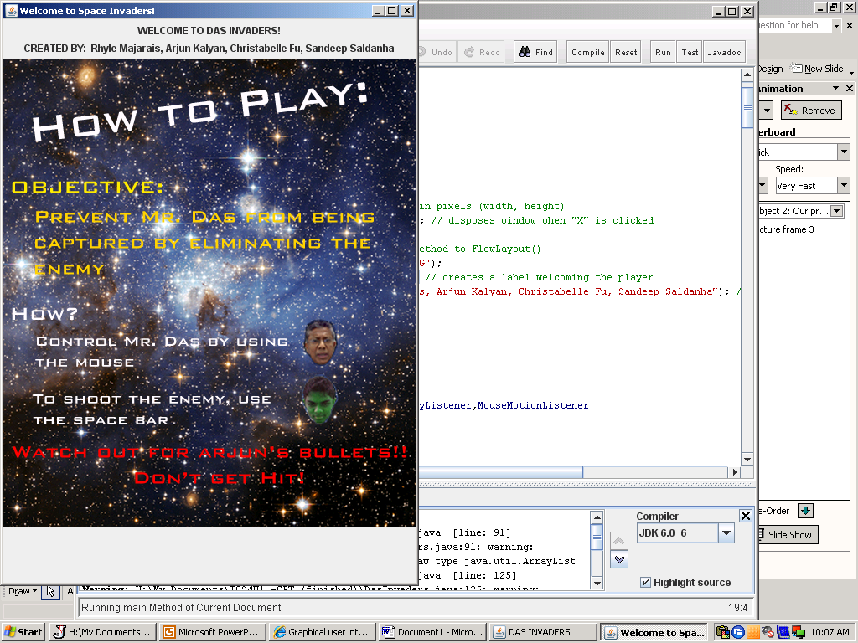
OUR PROGRAM
uses a graphical user interface to display the program.
To make a window, we used the JFrame method
EX. JFrame window = new JFrame(“This is a window”);
We used JLabel to display text and images without letting the user change it
EX. JLabel welcome = new JLabel("WELCOME TO DAS INVADERS!");

Slide 7
KeyListener is an interface component that listens for keyboard events (keys that are pressed)
To make this component register, you must include the “addKeyListener” method
When a key is pressed, the program then goes to the keyPressed,keyReleased, and keyTyped methods which tells the computer what to do
MouseMotionListener is an interface component that listens for movements of the mouse
Once again, to make this component register, you must include the “addMouseMotionListener” method
The program then goes to the mouseDragged and mouseMoved methods when it detects movements from the mouse

Slide 8
ArrayLists are similar to arrays
They hold classes and are used when you do not know the specific number of elements you need to hold
ArrayLists have something called a capacity which is the size of the array that is used to store lists
when more elements are added to the ArrayList, the capacity of it expands
To import images into the program, you must iclude a line similar to:
“ImageIcon howToPlay = new ImageIcon("howToPlay.png");”
This line imports the image named “howToPlay.png”

Slide 9
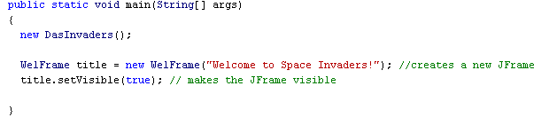
Explanation of Our Program
This is the main method of our program
It creates a JFrame for the welcome screen that pops up when the game runs
title.setVisible(true); makes the JFrame visible
If you don’t include this line, the window will not pop up

Slide 10
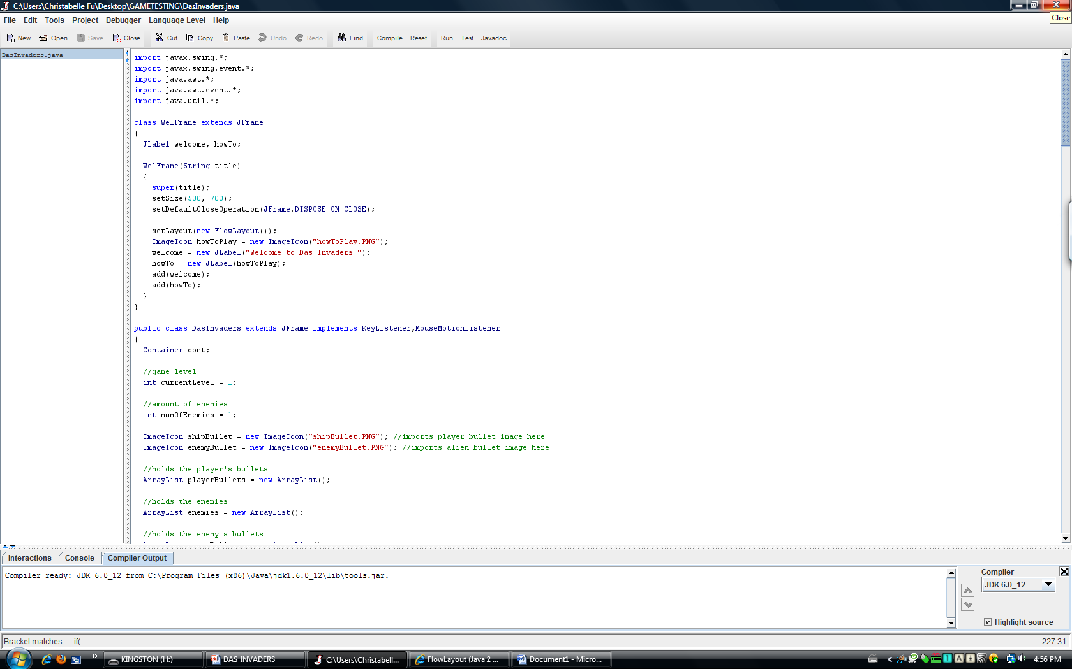
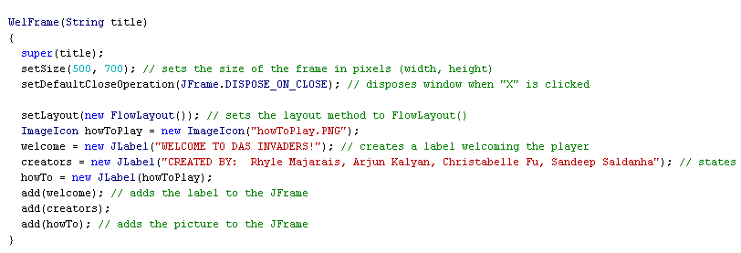
setSize(500, 700); sets the size of the window to 500 by 700 pixels (width x height)
setDefaultCloseOperation(JFrame.DISPOSE_ON_CLOSE);this gets rid of the window when the user clicks on the “X” at the top right corner without stopping the whole program
setLayout(new FlowLayout()); sets the layout method to FlowLayout();
welcome = new Jlabel(“WELCOME TO DAS INVADERS”); creates a label welcoming the user
add(welcome); adds the “welcome” JLabel to the window

Slide 11
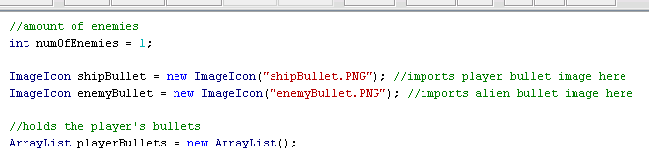
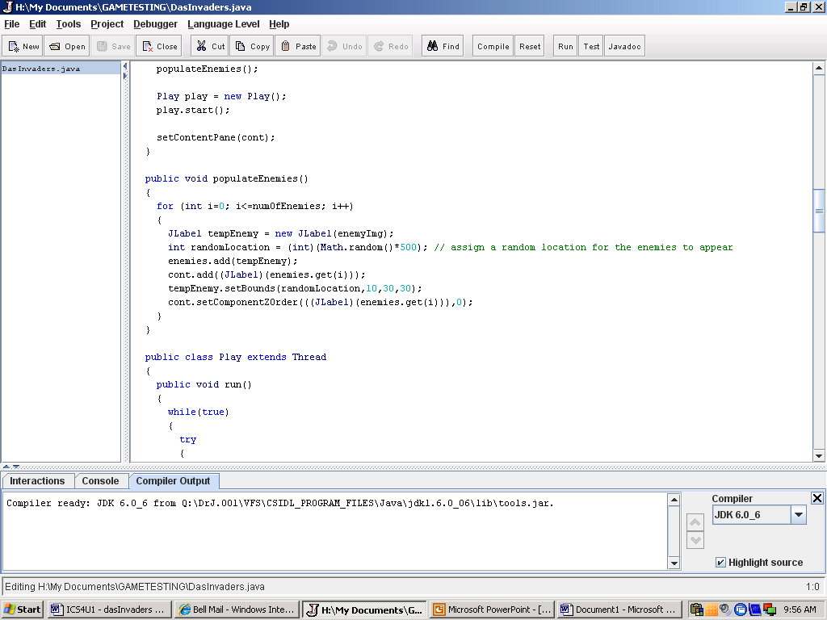
Imports images for the player’s bullet and the enemy’s bullet This ArrayList holds the number of player bullets
Math.random() assigns a random location for enemies to appear
setBounds sets the location of the enemy

Slide 12
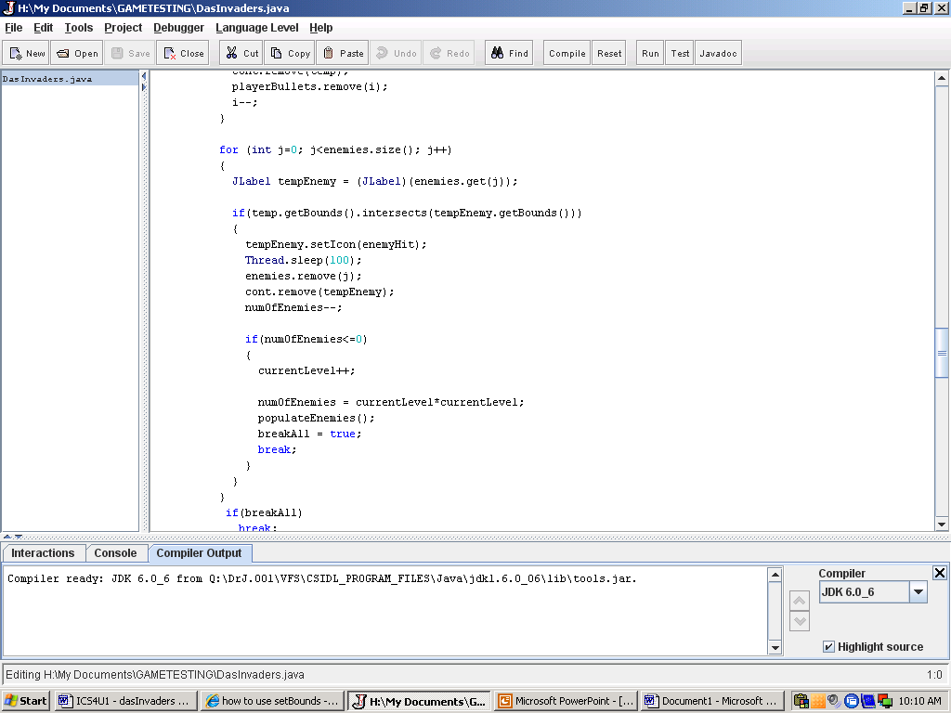
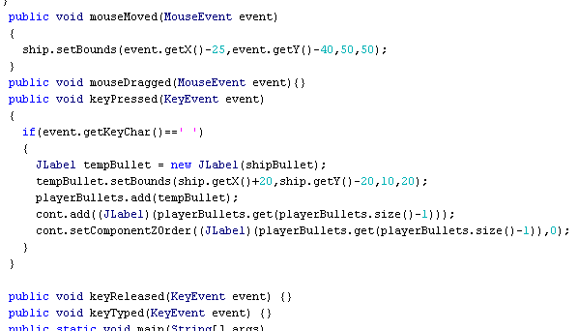
Thread.sleep(100); causes the current thread to suspend for 100 milliseconds
when the number of enemies becomes zero, the player advances to the next level and the program uses the populateEnemies() method to add more enemies to the game
This is a portion of the KeyListener and the MouseMotionListener events
It detects movements of the mouse and keys that were pressed and responds to it

Slide 13
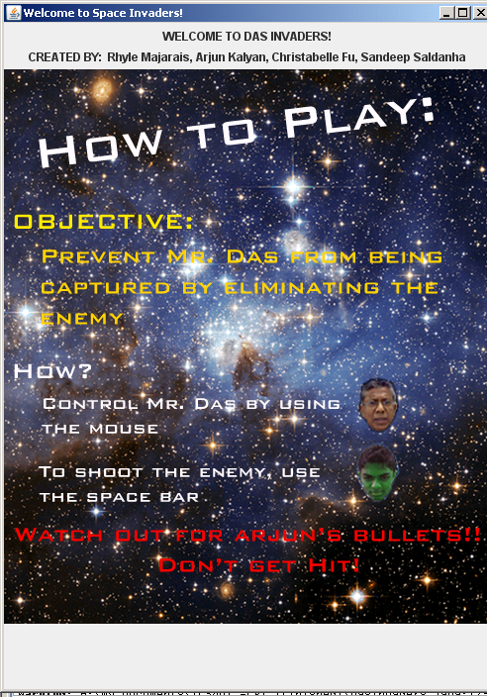
This is the welcoming window that pops up when Das Invaders is run

Slide 14
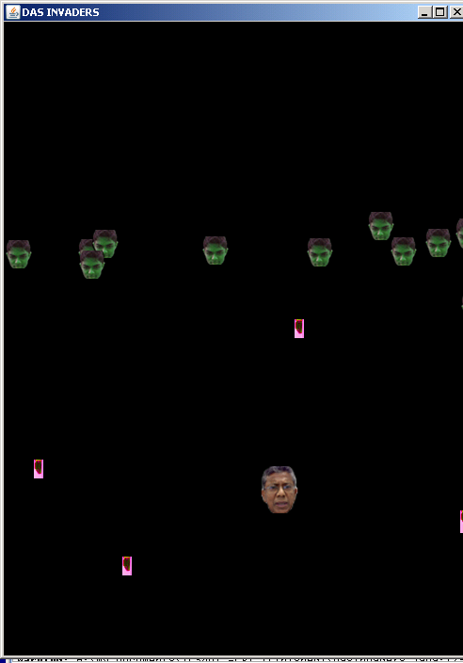
This is an image of the game being played

Slide 15
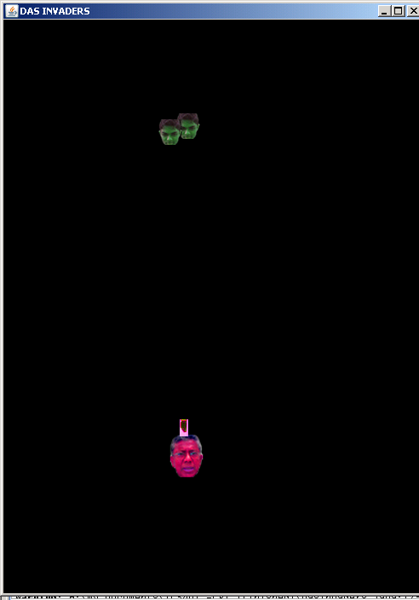
This is what it looks like when the Das Ship gets hit

Slide 16
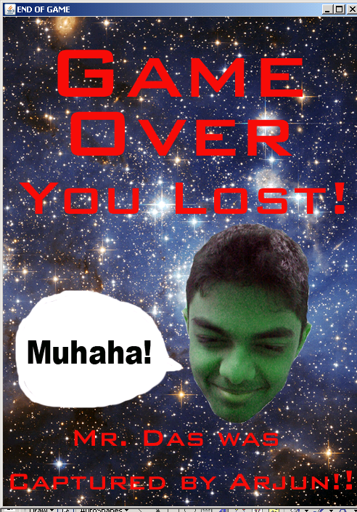
When the player gets shot, the Das Ship gets captured by the Arjunations

Slide 17
Problems We Encountered
We had trouble deciding what program we were going to make and whether it should be done on Python or Java
Typing errors caused our program not to compile
Couldn’t get the KeyListener and MouseMotionListener to work because we forgot to include “implements keyListener, MouseMotionListener” in the class declaration

Slide 18
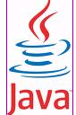
Images wouldn’t load properly
We originally included power ups and health packs into our game however, since the computers were so slow, we had to get rid of those components

Slide 19
REFERENCES
http://java.sun.com/j2se/1.4.2/docs/api/java/lang/package-summary.html
http://chortle.ccsu.edu/CS151/cs151java.html
http://java.sun.com/docs/books/tutorial/uiswing/
http://www.java-tips.org/java-se-tips/java.lang/use-of-arraylist-class.html
http://www.wirelessdevnet.com/channels/java/training/javagui.html

